Slide 1
Report Week 16 Classifying of Heart Sounds to detect cardiovascular
Instructors: ​
PhD. Tran Anh Vu​
MS. Hoang Quang Huy
Group 2 : Trịnh Khánh Ly – 20213676

Slide 2
Content
Problem
Related Work
Select dataset & Proposed method
Reference

Slide 3
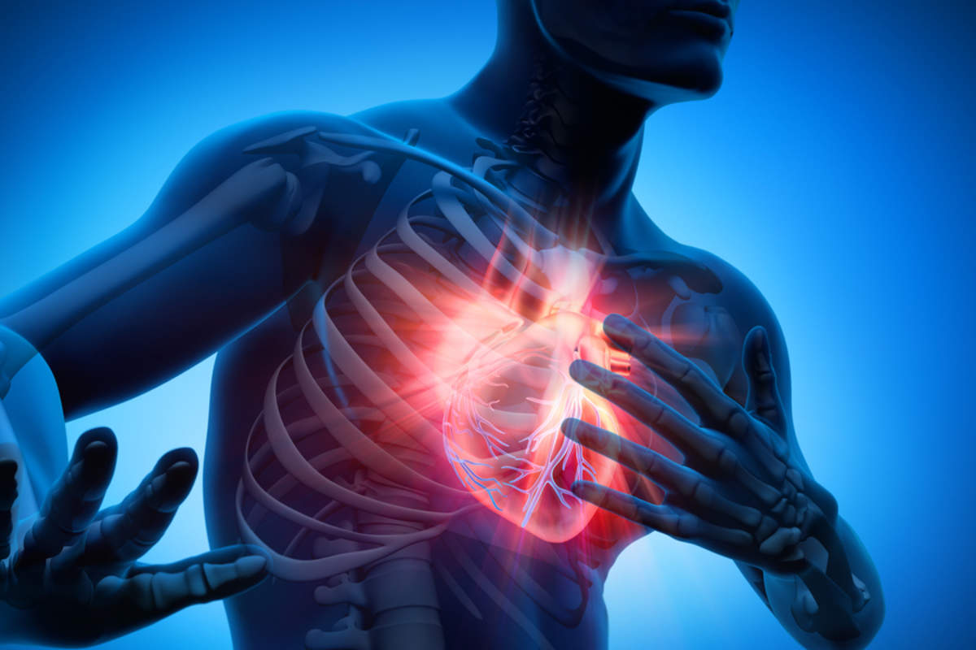
I. Problem
Heart attacks and strokes are responsible for 85% of global deaths due to cardiovascular disease
Heartbeat sounds, often referred to as phonocardiograms (PCGs), contain crucial diagnostic information that can aid medical professionals in assessing cardiac conditions, detecting anomalies, and monitoring patient well-being

Slide 4
I. Problem
Many different automated classifying approaches have been used
- Artificial neural network (ANN)
- Hidden Markov model (HMM)
- Multilayer perceptron-back propagation (MLP-BP)
- Wavelet coefficients and neural networks

Slide 5
II. Related work

Slide 6
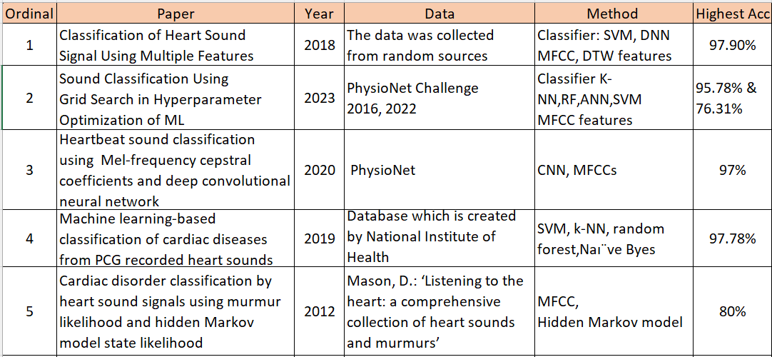
Literature Review

Slide 7
III. Select dataset & Proposed method

Slide 8
Select dataset
Heartbeat Sounds Classification – Analysis available on Kaggle
Dataset has been gathered from 2 sources:
(A) from the general public via the iStethoscope Pro iPhone app, provided in Dataset A (176 audio in .wav; set_a.csv)
(B) from a clinic trial in hospitals using the digital stethoscope DigiScope, provided in Dataset B (657 audio in .wav; set_b.csv)

Slide 9
Select dataset
Dataset have 833 data in total divided set_A & set_B,
4 feature:
dataset: a or b
fname: the audio file (.wav)
label: either "normal", blank (for unlabelled data), or one of various categories of abnormal heartbeats
sublabel: in set_b, some recordings are categorized as noisy, meaning they contain non-heart background noise; this field holds information on whether something is e.g. "noisynormal" or "noisymurmur"

Slide 10
Method
1. Exploratory Data Analysis
2. Data preprocessing
4. Testing&
Evaluate
3. Classification
Model

Slide 11
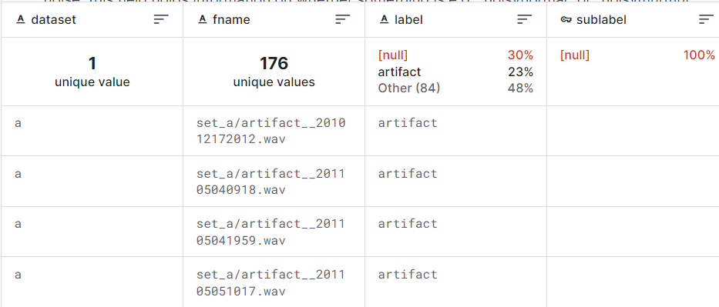
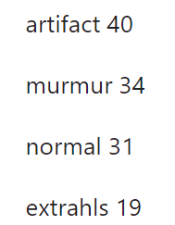
1.Data Exploratory analysis
Dataset A include 176 data, 4 feature, and divided 4 label categories
Label
1.
2.
3.
4.

Slide 12
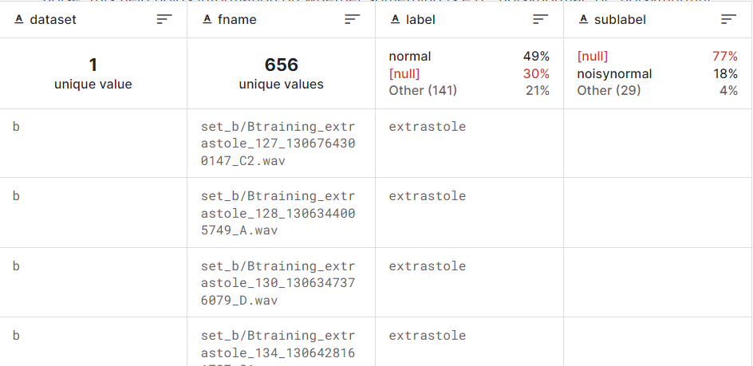
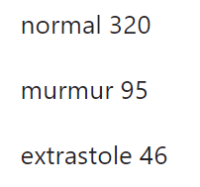
1.Data Exploratory analysis
Dataset B include 656 data, 4 feature, and divided 3 label categories
Label

Slide 13
1.Data Exploratory analysis
- We remove all null label entries from the dataframe, and also remove the artifact label entries dataset A since they are anomalies.
- We will need all 4 categories together to be able to classify, so join both sets A and B
The distribution of each class:
1. normal 351
2. murmur 129
3. extrastole 46
4. extrahls 19
New dataset

Slide 14
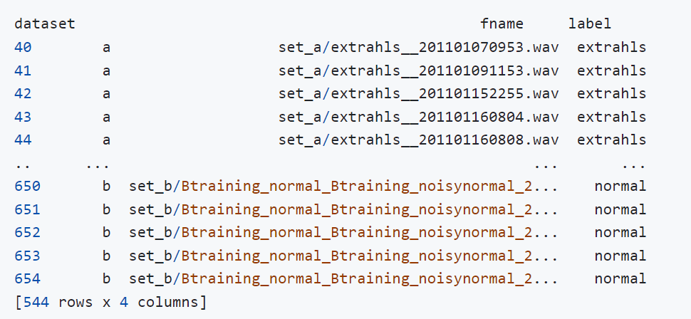
New dataset have 544 data, 4 features

Slide 15
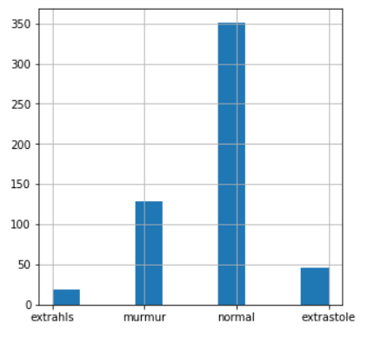
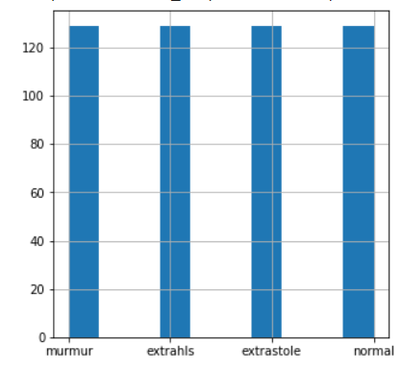
The problem
The data is very unbalanced, so we will upsample extrahls and extrastole and downsample normal
The distribution of each class:
normal (351), murmur (129), extrastole (46), extrahls (19)
The distribution of each class:
normal (129), murmur (129), extrastole (129), extrahls (129)

Slide 16
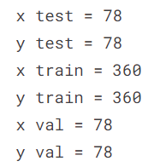
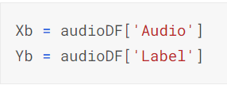
Spliting data for training & testing
Split the data 70% train, 15% validation, 15% test.

Slide 17
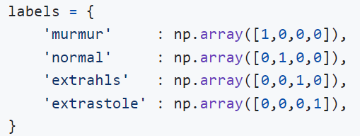
2. Data Preprocessing
The data is prepared for classification using the following steps:
The audio files are sampled at a constant rate of 22050 Hz.
The shorter audio files are padded with zeros to match the length of the longest audio file at 12 seconds.
The lables are one-hot encoded.

Slide 18
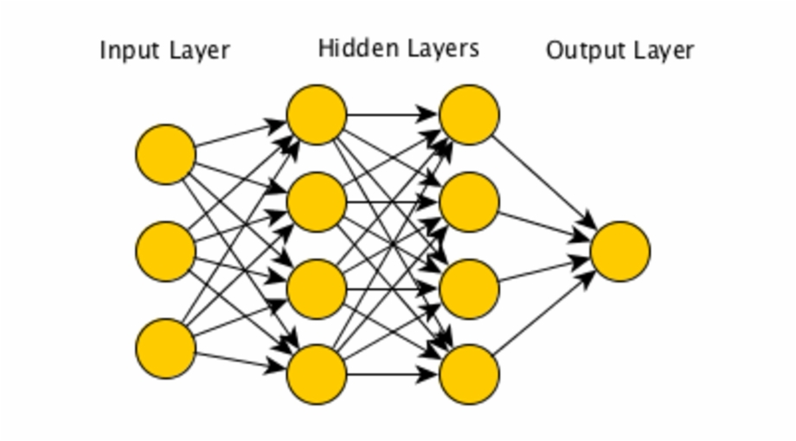
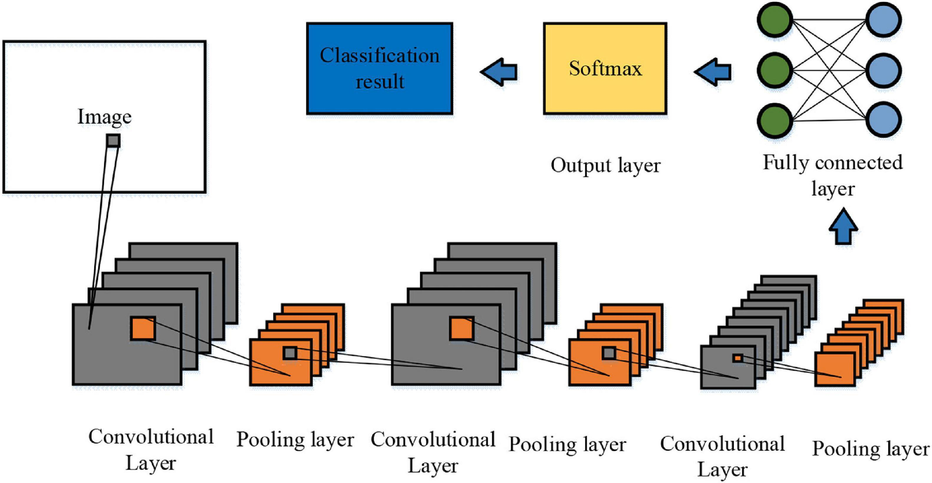
3. Classification models
VS
Feed Forward Fully Connected Neural Network
Convolutional Neural Network

Slide 19
Hyperparameters
3. Classification models
Hyperparameter | Value
Learning Rate Schedule | Step Decay
Learning Rate Factor | 2.00E-05
Learning Rate Patience | 35
Activation Function | ReLU , Softmax
Optimizer | Adam
Loss Function | Categorical Cross Entropy
Epochs | 500
Early Stopping | TRUE
Early Stopping Patience | 50

Slide 20
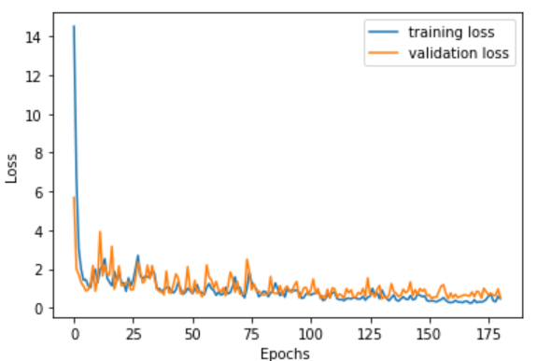
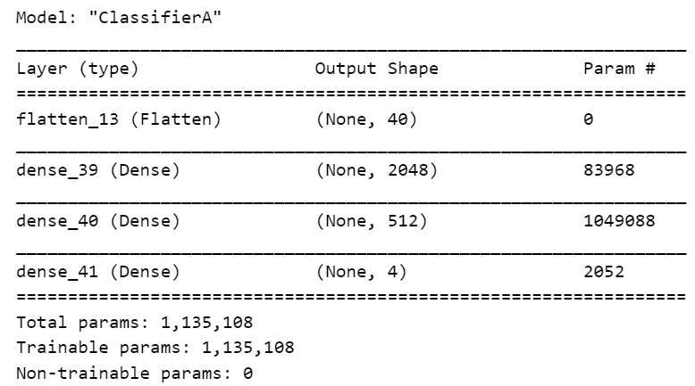
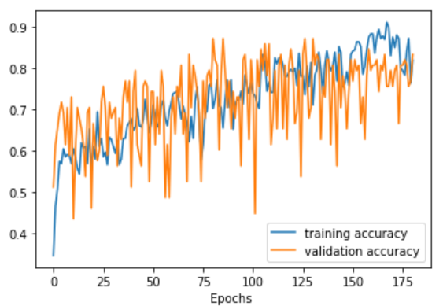
A, Feed Forward Fully Connected Neural Network
Architecture 1
5ms/step - loss: 0.6616 - accuracy: 0.8718

Slide 21
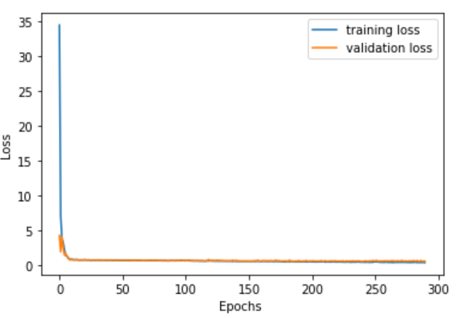
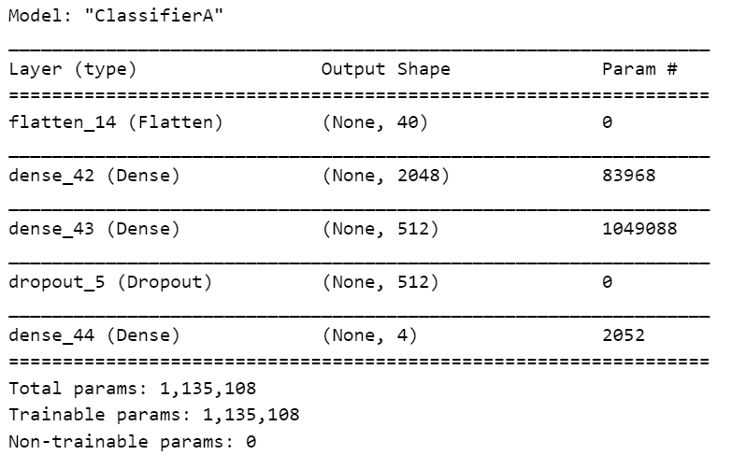
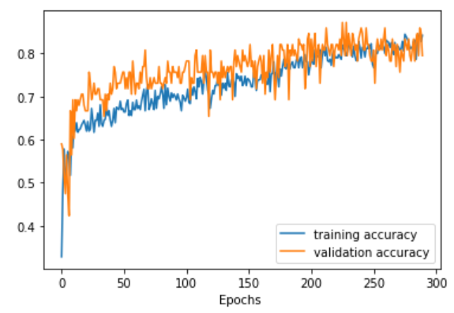
A, Feed Forward Fully Connected Neural Network
Architecture 2
We add regularization to the model to prevent overfitting.
4ms/step - loss: 0.5999 - accuracy: 0.7949
=> Model with regularization is much better so we discard the first result.

Slide 22
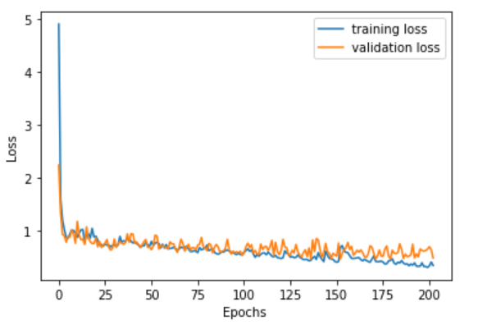
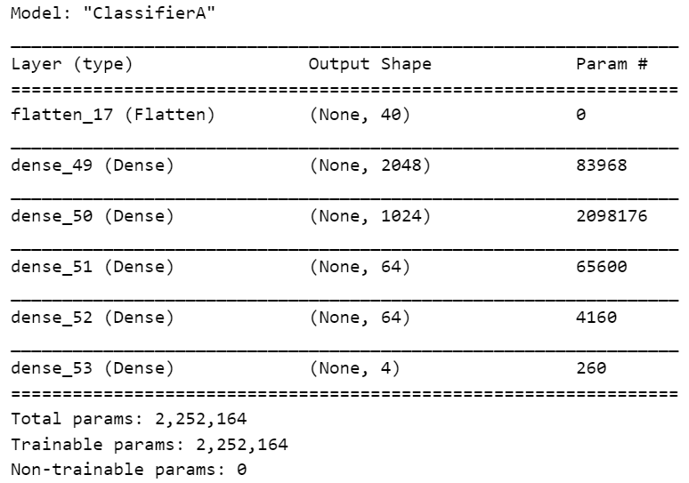
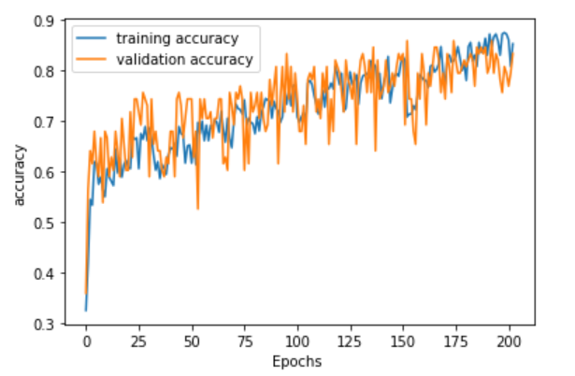
A, Feed Forward Fully Connected Neural Network
Architecture 3: Going deeper
8ms/step - loss: 0.4959 - accuracy: 0.8333

Slide 23
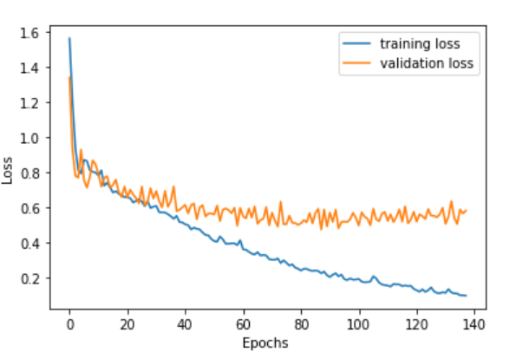
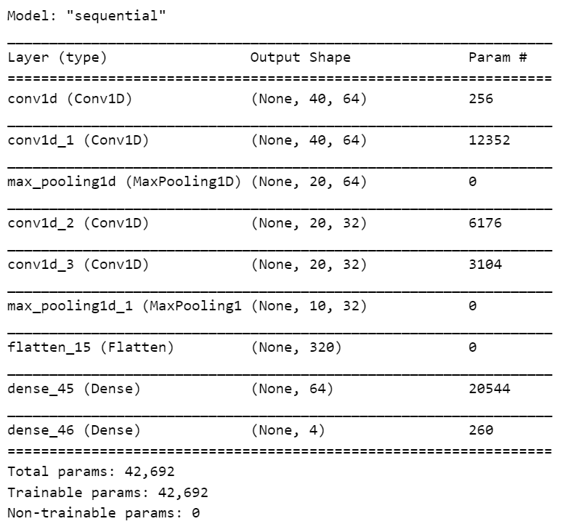
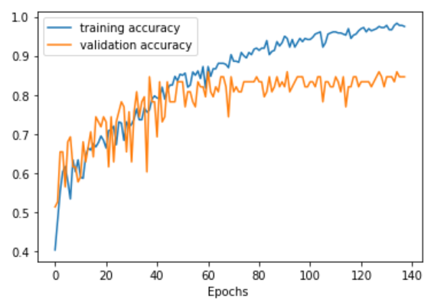
B, Convolutional Neural Network
Architecture 1 : 1D Convolutional Neural Network
27ms/step - loss: 0.5836 - accuracy: 0.8462

Slide 24
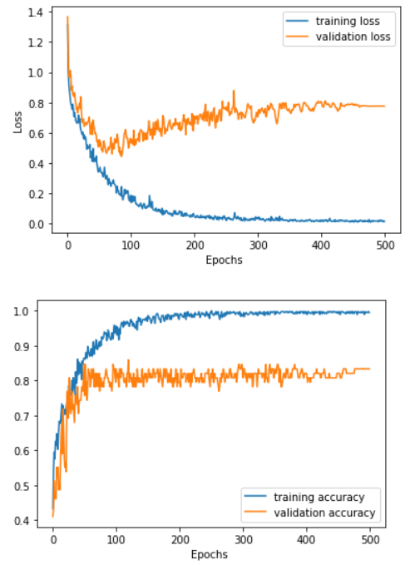
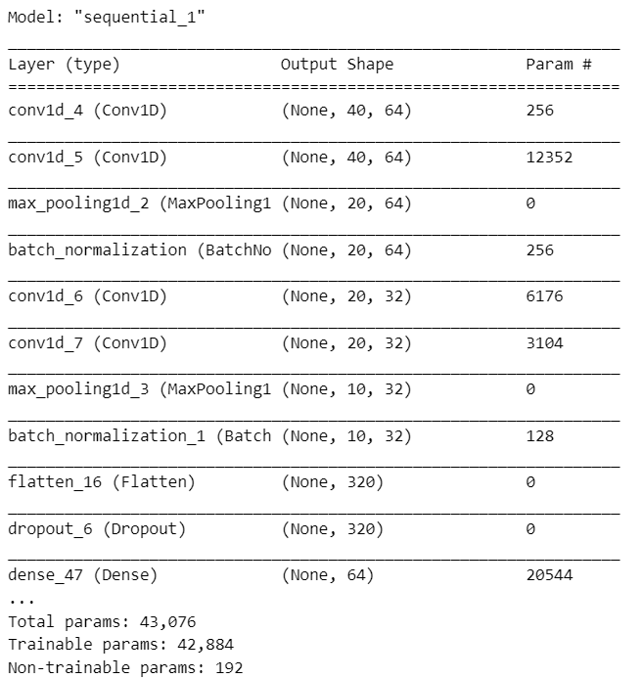
B, Convolutional Neural Network
Architecture 2 : Regularized 1D Convolutional Neural Network
7ms/step - loss: 0.7757 - accuracy: 0.8333

Slide 25
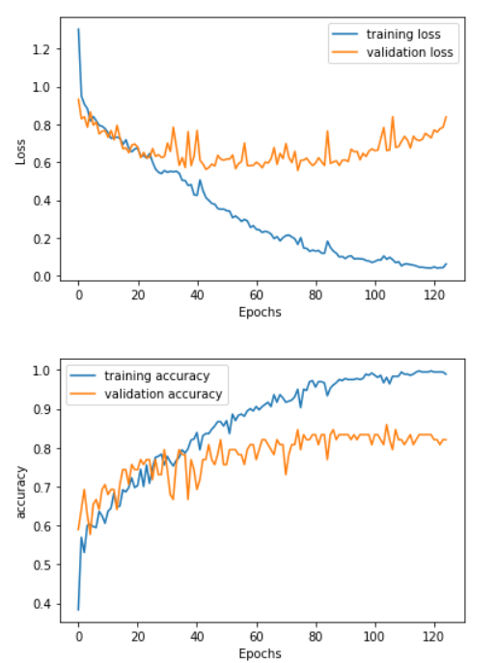
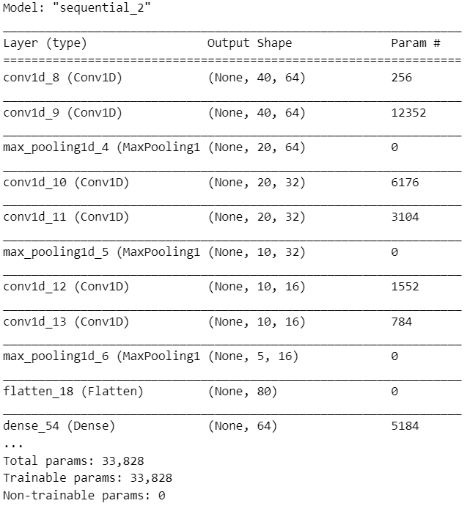
B, Convolutional Neural Network
Architecture 3 : Deeper 1D Convolutional Neural Network
6ms/step - loss: 0.8390 - accuracy: 0.8205

Slide 26
Select the best models
Model |  | Validation
FFNN | Architecture 1 | loss: 0.6616 | acc: 0.8718
 | Architecture 2 | loss: 0.5999 | acc: 0.7949
 | Architecture 3 | loss: 0.4959 | acc: 0.8333
CNN | Architecture 1 | loss: 0.5836 | acc: 0.8462
 | Architecture 2 | loss: 0.7757 | acc: 0.8333
 | Architecture 3 | loss: 0.8390 | acc: 0.8205
Deeper FFNN is the best
1D CNN is the best

Slide 27
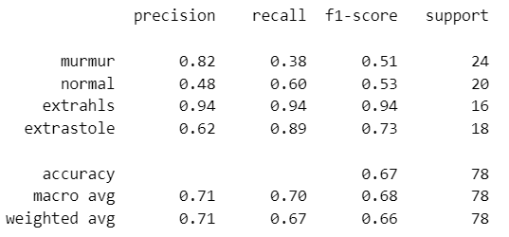
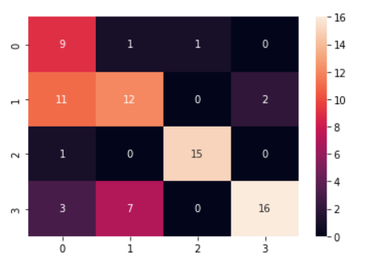
4. Testing & Evaluate
Classification Report for Deeper FFNN Model
Test 6ms/step - loss: 0.7822 - accuracy: 0.6667

Slide 28
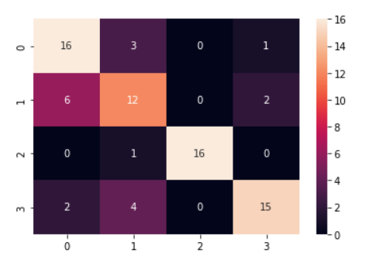
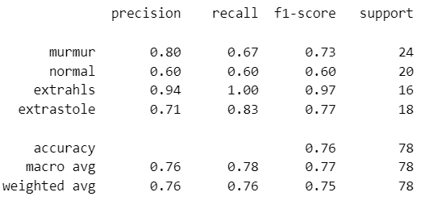
4. Testing & Evaluate
Classification Report For CNN
Test 5ms/step - loss: 0.8406 - accuracy: 0.7564

Slide 29
Conclusion
CNN models take much less time to train than feed forward networks.
The accuracy of the CNN models is not as good as the feed forward networks.
Regularization by adding dropout does not always prevent overfitting.

Slide 30
Reference
1. Yaseen; Son, G.-Y.; Kwon, S. Classification of Heart Sound Signal Using Multiple Features. Appl. Sci. 2018, 8, 2344. https://doi.org/10.3390/app8122344
2. Fuadah, Y.N.; Pramudito, M.A.; Lim, K.M. An Optimal Approach for Heart Sound Classification Using Grid Search in Hyperparameter Optimization of Machine Learning. Bioengineering 2023, 10, 45. https://doi.org/10.3390/bioengineering10010045
3. Heartbeat sound classification using Mel-frequency cepstral coefficients and deep convolutional neural network, 2020
4. Machine learning-based classification of cardiac diseases from PCG recorded heart sounds, 2019
5. Cardiac disorder classification by heart sound signals using murmur likelihood and hidden Markov model state likelihood, 2012
Link

Slide 31
THANK YOU

